Slide 1
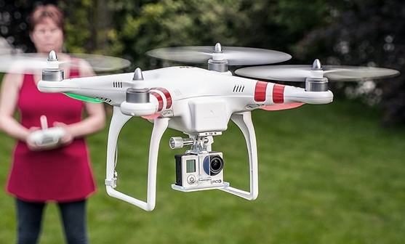
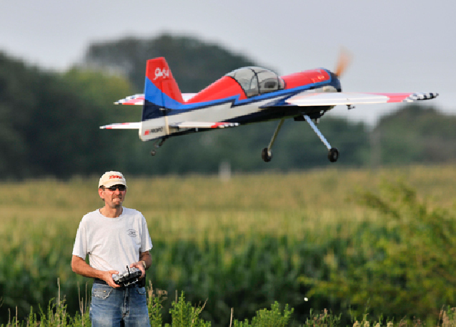
Current Best Practices and Precedents
Existing UAV Guidelines/Best Practices

Slide 2
GAO: UAVs create a new privacy paradigm
One of the leading privacy theories is the right to control information about oneself.
This paradigm works in some mediums…However, with drones and aerial surveillance … this theory of privacy breaks down

Slide 3
2nd Restatement of Torts
Publicity given to private facts:
  One who gives publicity to a matter concerning the private life of another is subject to liability to the other for invasion of his privacy, if the matter publicized is of a kind that (a) would be highly offensive to a reasonable person, and (b) is not of legitimate concern to the public.
  This gets into collection AND sharing.
Intrusion Upon Seclusion
  One who intentionally intrudes, physically or otherwise, upon the solitude or seclusion of another or his private affairs or concerns, is subject to liability to the other for invasion of his privacy, if the intrusion would be highly offensive to a reasonable person.

Slide 4
Recent Court Actions – 3rd Circuit
“[N]o person of ordinary sensibilities would be shamed, humiliated, or have suffered mentally as a result of a vehicle entering in his or her ungated driveway and photographing him or her from there. [The house, pool, and driveway could] be seen by any person who entered onto their driveway, including a visitor or a delivery man.”
    Boring v. Google, Inc., No. 09-2350, 362 Fed. Appx. 273 (3d Cir. 2013).

Slide 5
EPIC, ACLU, and CDT letter to FAA
“Companies are developing ‘paparazzi drones’ in order to follow and photograph celebrities. Private detectives are starting to use drones to track their targets…Criminals and others may use drones for purposes of stalking and harassment.”
  Concerns are “harassment,” “stalking” which are already illegal
  Private detectives are a regulated industry.
“[I]ncreases the First Amendment risks for would be political dissidents”
  Could limit the ability of dissidents to use UAVs to expose bad activity

Slide 6
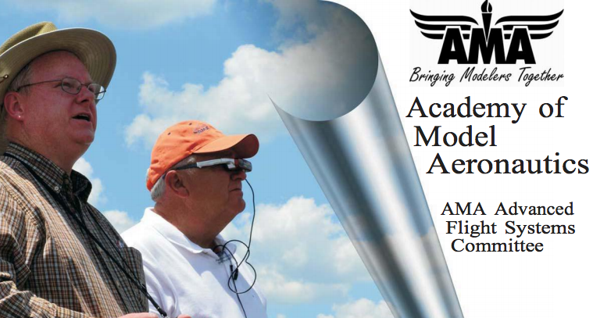
Academy of Model Aeronautics AMA Advanced Flight Systems Committee

Slide 7
Strict Prohibition without prior consent
The use of imaging technology on radio control model aircraft with the capability of obtaining high-resolution photographs and/or video, or using any types of sensors, for the collection, retention, or dissemination of aerial surveillance data/information on individuals, homes, businesses or property, is strictly prohibited by the AMA unless expressed written permission is obtained from the individuals, property owners or managers.
But this is designed for FPV model aircrafts – “FIRST PERSON VIEW (FPV) refers to the operation of a radio controlled (RC) model aircraft using an onboard camera’s cockpit view to orient and control the aircraft”

Slide 8
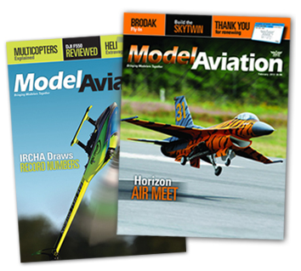
May work for AMA Members but not UAVs
This is what AMA Members use… not exactly the same thing that DGI uses.

Slide 9
Unmanned Aircraft System Operations: Industry Code of Conduct
“We will respect the privacy of individuals.”

Slide 10
What do these best practices and precedents generally have in common?
Respect for expectation of privacy
Violations require intent to cause harm:
  Whether making public images with intent to embarrass
Best practices can address issues of:
  Privacy when expected
  Transparency and Accountability, and
  Data security.

Slide 11
So that’s where we are today where do we go tomorrow?

Slide 12
Proposed Stakeholder Privacy best practices for the operation of Unmanned Aerial Vehicles
Section 1: Applicability
  Both commercial and non-commercial
Section 2: Definitions
Section 3: Requirements of UAV Operations
  Don’t knowingly and intentionally use a UAV to record:
    Without the knowledge or consent of the person being recorded
    Where there is a has a reasonable expectation of privacy AND
    Except to the extent that the person is reasonably unidentifiable

Slide 13
Proposed Stakeholder Privacy best practices for the operation of Unmanned Aerial Vehicles
Section 4: Transparency Requirements
  A commercial operator should have an online privacy policy and POC
  A non-commercial operator should clearly and consciously label their UAV with info
Section 5: Data Security Mandate
  Should take reasonable steps to store information securely
Section 6: Protecting First Amendment and Safety
  These best practices should not impede: use of UAVs for purposes of news or public information services.
  These best practices should not impede: use of UAVs for purposes of safety and rescue responses
  These best practices should not take precedent over the safe operation of a UAV

