Slide 1
NTIA Privacy Multistakeholder Meeting March 25, 2014 Amanda Koulousias, Attorney Division of Privacy and Identity Protection Federal Trade Commission
FTC Staff Report:
Facing Facts - Best Practices for Common Uses of Facial Recognition Technologies
The views expressed are those of the speaker and not necessarily those of the FTC.

Slide 2
Panelists discussed a range of technologies:
pure facial detection
age and gender recognition
emotion recognition
facial recognition
Major topics included:
Advances in the technology
Current and potential future commercial uses
Benefits & privacy concerns
Face Facts: A Forum on Facial Recognition Technology
December 8, 2011

Slide 3
Public Comment Period
December 2011 - January 2012
Issues for comment included:
Current and future uses
Benefits to consumers
Privacy and security concerns
Best practices for building privacy into products and when and how to provide consumers with notice and choice
The FTC received 80 public comments from a variety of stakeholders

Slide 4
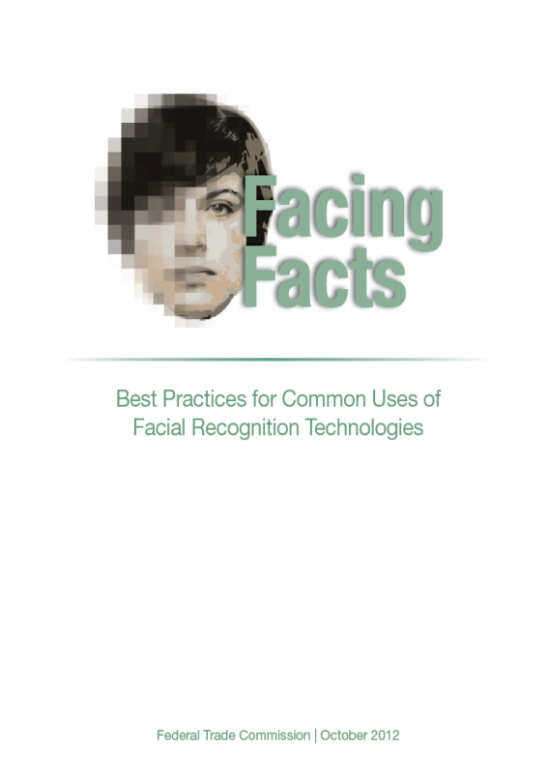
FTC Staff Report: Facing Facts – Best Practices for Common Uses of Facial Recognition Technologies
October 2012
Important Points:
The report contains recommendations for best practices
It is not a template for law enforcement actions or regulations under laws currently enforced by the FTC
The recommendations build on the workshop and the public comments
The report uses 3 case studies as an example to discuss best practices

Slide 5
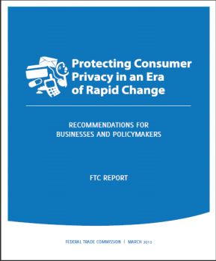
FTC Staff Report: Facing Facts – Best Practices for Common Uses of Facial Recognition Technologies
October 2012
The recommendations describe how companies can implement the principles contained in the FTC’s March 2012 Privacy Report:
Privacy by Design
Simplified Consumer Choice
Transparency

Slide 6
Case Study: Detection or Recognition of Demographic Characteristics in Digital Signs
Privacy by Design:
Reasonable data security protections to prevent unauthorized access to the images
No signs in sensitive areas
Limited data retention
Simplified Choice & Increased Transparency:
Clear notice to consumers that these signs are in use – before the consumer comes into contact with the sign
Obtain affirmative express consent before individually identifying consumers through these signs

Slide 7
Case Study: Facial Recognition in Online Social Networks
Privacy by Design:
Reasonable data security for the database of images & biometric data
Protections in place to prevent unauthorized scraping of publicly available images in the database
Appropriate retention and disposal practices

Slide 8
Case Study: Facial Recognition in Online Social Networks (continued)
Simplified Choice and Increased Transparency:
Clear notice – outside of a privacy policy – when the feature is rolled out
Offer consumers an easy to find choice not to have biometric data collected and used for facial recognition
Do not collect or store biometric data of non-users of the service because there is no context in which to provide such non-users with a choice about these practices

Slide 9
Case Study: Facial Recognition in Online Social Networks (continued)
Situations in which affirmative express consent should be obtained:
Before using a consumer’s image or biometric data in a materially different manner than represented when the company collected the data
Identifying a user to another user who is not their “friend”
Recommendation applies beyond social networks:
Only identify anonymous images of consumers to someone who could not otherwise identify them if the consumer has affirmatively opted in to such a system

Slide 10
Questions?

