Slide 1
Face Processing in Social Networking Services
NTIA Privacy Multistakeholder Process:
Commercial Facial Recognition Technology
March 25, 2014
Olga Raskin
Manager, Identity Research
Copyright © 2014
IBG, A Novetta Solutions Company

Slide 2
IBG at a Glance
IBG has conducted independent biometric testing since 1996
Hundreds of thousands of man-hours in biometric research, design, and integration (e.g. fingerprint, face, iris recognition)
Expertise in emerging modalities, sensors, and software
Cutting-edge expertise in virtual, online, and electronic identity technologies, concepts, and platforms
Extensive commercial and government customer base

Slide 3
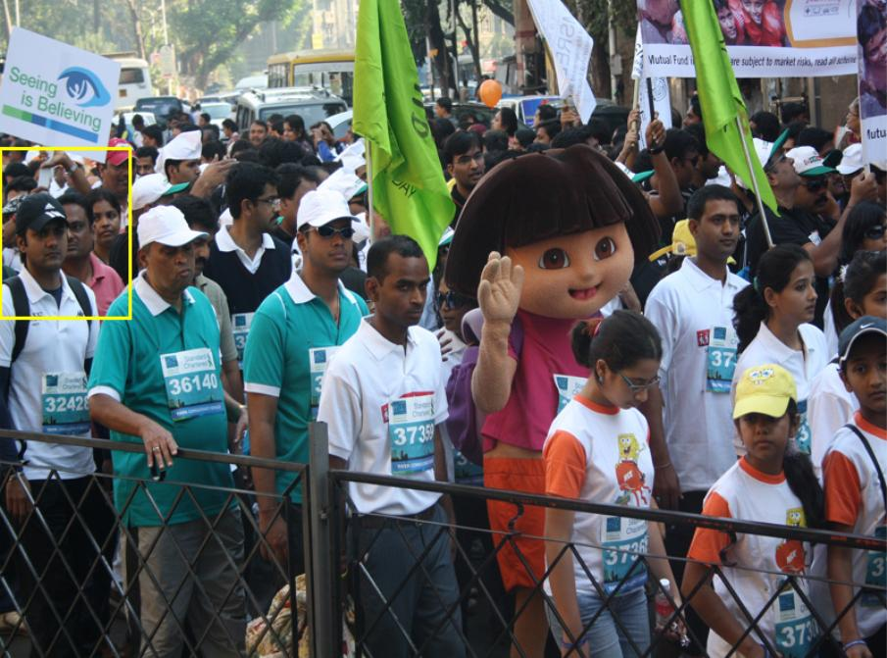
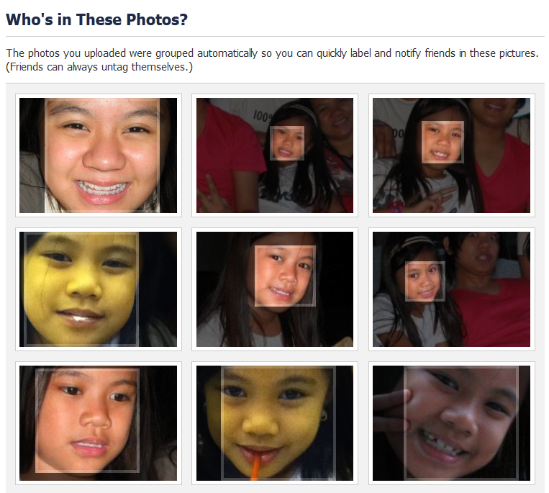
Background
IBG evaluates online face processing technologies, capabilities, and performance
While online face processing is the largest commercial use of biometrics, its performance and capabilities are not well-understood

Slide 4
Face Processing Functions
Detection
Automated location of one or more faces in an image
Cropping
Extraction and presentation of an image’s facial region
Recognition
Search of a face image against enrolled face images to identify potential matches
Grouping
Automated organization of face images into sets based on appearance similarity
Tagging
Automated or facilitated process of assigning names to faces in online photos

Slide 5
Face Processing Myth: Image Quality
Myth
Face recognition requires high-quality images
Reality
SNS face processing systems can detect and match low-quality faces
Profiles, faces with low inter-ocular distance, bad lighting
Faces acquired through different classes of camera
Future
Matching and detection technologies should continue to improve (though other factors are involved)

Slide 6
Face Processing Myth: Online Face Searches
Myth
You can conduct a “global” face search against the whole Internet
Reality
No, you cannot
Most online face images are not searchable (private, not shared)
Searches are within one’s contacts / friends
Sites that offer 1:N searches against public images lack identity data
Future
Facebook, Google have shown no interest in enabling open searches
Other entities are surely saving every public and/or accessible face image for future use

Slide 7



Relevant Face Processing Technologies
Facebook
By far the largest “consumer” usage of biometrics
Rich social graph available to deliver improved tag suggestions
Google+
Google's SNS, for which face processing was activated in December 2011
Potential for expansion of face processing to services such as search, Android, location, and YouTube
PittPatt
Founded in 2004 by members of the Carnegie Mellon University Robotics Institute
Acquired by Google in 2011; no longer in development
Used by government agencies to process low-quality images

Slide 8
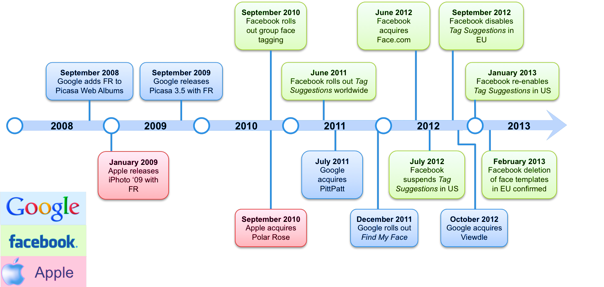
Milestones in Online Face Processing

Slide 9
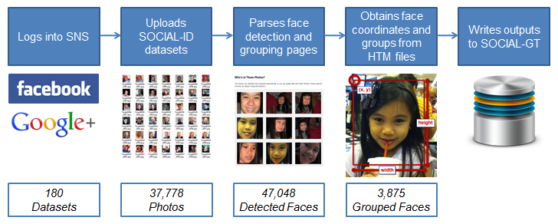
Dataset Processing
IBG created software that automates photo submission and results parsing for and Facebook / Google+
Otherwise the process is manual, burdensome, and error-prone
SOCIAL-ID: photos collected by IBG as well as from public sources
SOCIAL-GT: customized testing software that interacts with online face processing sites and services; used by analysts for adjudication

Slide 10
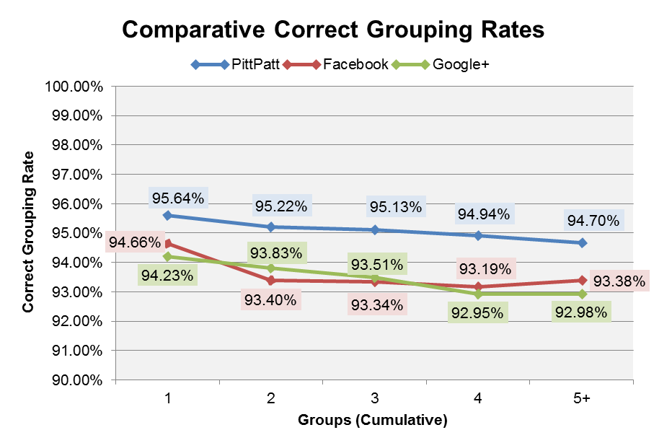
Face Grouping Performance
Correct grouping rates are similar for the three services
PittPatt has a slightly lower error rate than Facebook or Google+
For datasets with a pronounced primary identity, approximately 19 out of 20 groupings will be correct
Notes:
Correct grouping rates shown are cumulative: grouping rates for Group 2 include results for Group 2 and Group 1, grouping rates for Group 3 include Groups 3, 2, and 1, and so forth.

Slide 11
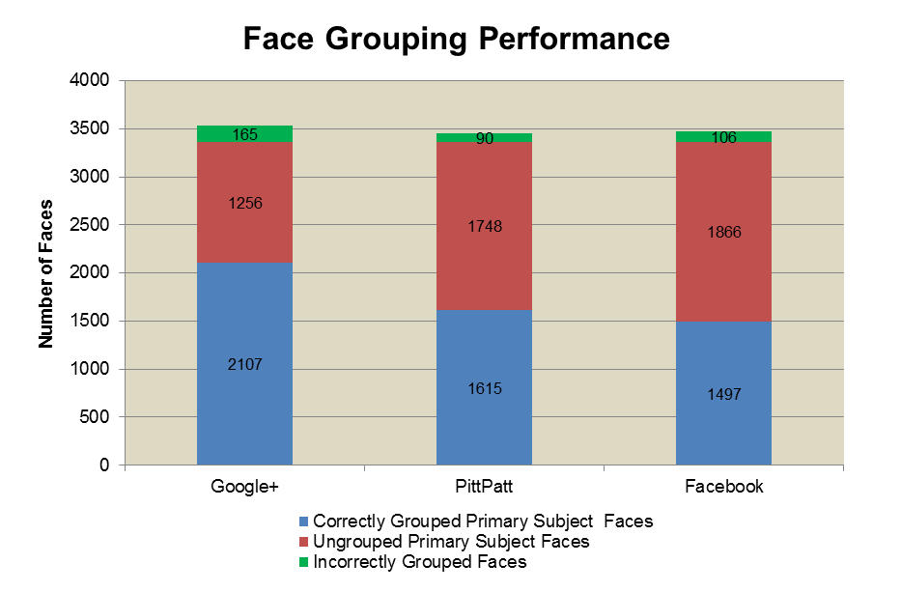
Face Grouping Performance
Google+ correctly groups 500-600 more Primary Subject faces than PittPatt and Facebook, respectively, while incorrectly grouping only 60-70 more faces

Slide 12
Conclusions
Searches are predominantly in-network
Online face processing services can achieve correct grouping rates above 90% on challenging images
Not reliant on frontal poses, neutral expressions, even illumination, etc.
Online face processing is improving
Algorithms may be tuned based on user input (e.g. tagging/grouping confirmations)
Possible enhancements to core face processing technologies

Slide 13
Contact Information
Olga Raskin
IBG, A Novetta Solutions Company
oraskin@novetta.com

