Slide 1
“Face Recognition Technology Today” before the NTIA Multi-Stakeholder Process To Develop Consumer Data Privacy Code of Conduct Concerning Facial Recognition Technology February 25, 2014
Dr. Marc Valliant, VP & CTO

Slide 2
Facial Recognition Applications in Use Today
Examples
Commercial:
Employers for Time and Attendance Verification
Physical Access Control Security (Buildings)
Logical Access Control (Computer/Device Access)
Document Authentication
Government:
Drivers Licenses to reduce duplication and fraud
Passport Verification
Jail Management Systems and Booking
Law Enforcement Investigations
Social/consumer:
Photo Organizing Google’s Picassa, Facebook
Smartphone and App Access Control

Slide 3
Defining Face Recognition
Computer Facial Recognition is the determination of an anonymous or unknown identity of a human being based on the facial characteristics and features derived from camera or digital photo
Methods: 1:1 Verify and 1:Many Search
Other Applications often called Facial Recognition but are not:
Face Detection - finding the FACES, not identifying who in the photo
Gender Determination
Age Range Determination

Slide 4
Face Recognition is based on Face Biometric Templates
Face Biometric Template is…
Versus an Identifier
Not the actual facial image
A vector of numbers which represent the facial image’s characteristics including measurements, color, lighting, 2D/3D
Created by a Face Biometric Algorithm
Not standard format and varies between different algorithms. Usually proprietary.
Different for each photo even of the Same Person
Not a match between two templates, only a degree of statistical closeness
Social Security No., Drivers License No., Passport No.
Binary match or no match
Biometric Template (face, fingerprint, or iris) + Name and Meta Data together is an Identifier

Slide 5
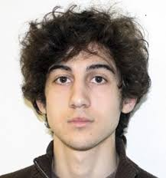
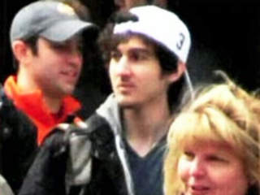
Why wasn’t Dzhokhar Tsarnaev identified by the Massachusetts Department of Motor Vehicles system from the video surveillance images?
?
DMV Face Recognition System
Notes:
Dzhokhar Tsarnaev was not identified by face recognition
Surveillance video had captured his face
He was enrolled in the Mass. DMV database

Slide 6
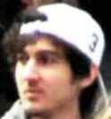
Controlled Facial Photo
Today’s FR technology will reliably find this photo in a mugshot database of controlled facial images

Slide 7
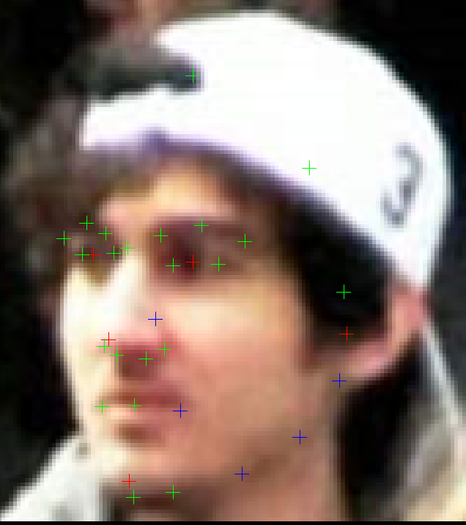
Confounding Variables in Uncontrolled Facial Photos
Problematic variables:
Resolution (not enough pixels)
Facial Pose – angulated
Illumination
Occluded facial areas
What happens:
Facial Feature Points (eyes, etc.) not found or distorted
Algorithm Measurements in Error
Not Enough Data to Process
Notes:
Head Rotation / Facial Pose - causes occlusions and changes geometric measurements
Image Resolution - how many pixels….the raw data
Lighting and Shadows – prevent finding facial features accurately
Facial Accessories (eg. Hoodie, Hat, Dark Sun Glasses, Make up) – causing more occlusions, loss of parts of the face

Slide 8
Defining a Facial Recognition MATCH Degree of Similarity
A statistical score between two face biometric templates
Based on a facial characteristics algorithm determines degrees of SIMILARITY or a Score
If the Score meets a certain threshold, then it is considered a Match
Thresholds are determined by the operating parameters required
Operating Parameters are defined by an acceptable error rate for the applications use

Slide 9
Defining Error Rates
False Accept: System claims a pair of pictures are a match, when they are actually pictures of different individuals.
False Accept Rate (FAR): Frequency that the system makes False Accepts
Example: FAR of 0.1% system will make 1 false accept for every 1000 imposter attempts
False Reject : System claims a pair of pictures are a mismatch, when they are actually pictures of the same individual
False Reject Rate (FRR): Frequency that the system makes False Rejects
ID Rate = 100% minus FRR
E.g.: FRR of 2% or Identification rate of 98% system will reject 2 matches for every 100 authorized attempts
As FAR is lowered, expect ID Rates to lower

Slide 10
Error Rates in Practice
Operation implications
Control ID Rate by selecting the FAR operating point
Desire FAR to be as low as possible….. Minimize imposters
If ID Rate is too low, then forcing the subject to try again, and again
No standards exist for “acceptable” error rates, or a rating system, meaning “success” is deemed different within every vendor product, and in every application purpose.

Slide 11
Useable Error Rates Vary by App
App Examples ID RATE FAR
Access Control Normal 90% 0.10%
Access Control High Security 80% 0.01%
Time and Attendance 85% 0.10%
Drivers License/Passport Deduplication 97% 1.00%
Mobile Phone Authentication 75% 0.20%
Facebook Private Photo Search 75% 1.00%

Slide 12
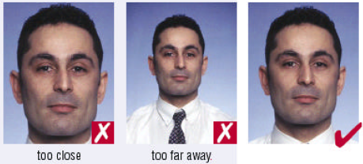
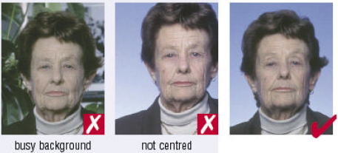
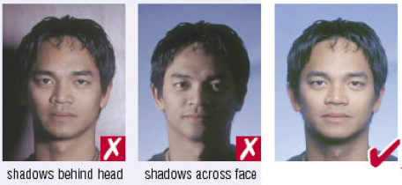
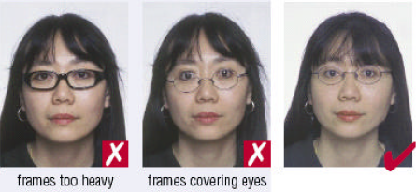
Even mugshots will reduce id rates if not “controlled”
Mugshots are subject to control standards, the “Uncontrolled Face Use Standards ISO/IEC 19794-5 “for Enrollments.
Variables like lighting, glasses, background, slight pose, face proportion can cause errors.
Notes:
It does not take much for most 2D FR systems to fail or return low scores.
way back in 2004 a standard guideline for acquiring a facial image was created..
The Controlled Face Standard is ISO/IEC 19794-5 & ANSI INCITS 385-2004
For Visualization
For Accuracy in Computerized Face Recognition Systems (“Lights out”)
Important for Enrollment , i.e. at Booking

Slide 13
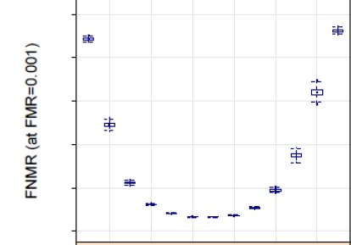
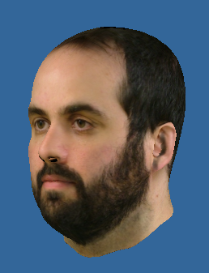
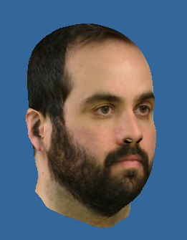
Uncontrolled Facial Imagery = High Error Rates
NIST
0%
20%
40%
60%
80%
100%
ID RATE
False
Accept
Rate
Set
0.1%
Notes:
FR systems unable to consistently verify/match to standards for “blind admission” in courtroom
Effective with “controlled facial imagery” but not with uncontrolled facial image
Law enforcement (LE) and Intelligence community (IC) rarely deal with controlled data

Slide 14
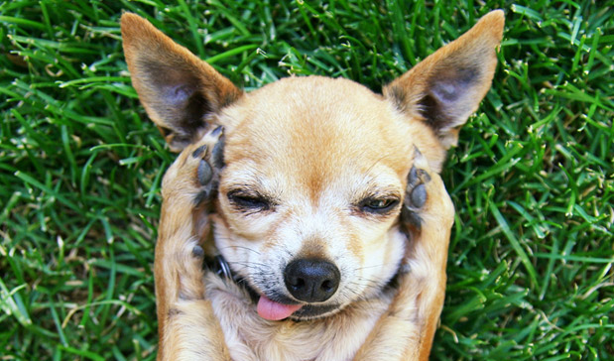
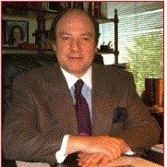
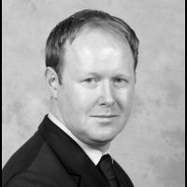
Can a controlled photo find a match in LinkedIn?

Slide 15
LinkedIn Facial Search: Possible but dependent on the input photo and the database enrollment
LinkedIn are Faces in the Wild
Assuming you can scoop all the faces for enrollment into a DB
Very low chances in matching
Conjecture: If LinkedIn forced an IEC/ISO Mugshot standard then you’d have a searchable database

Slide 16
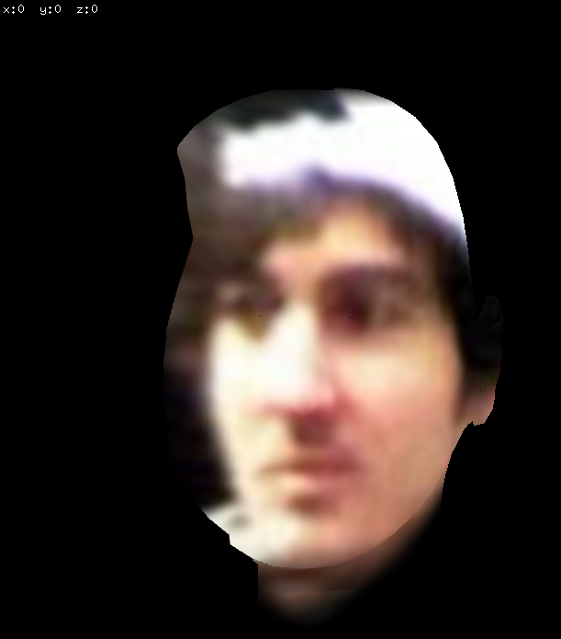
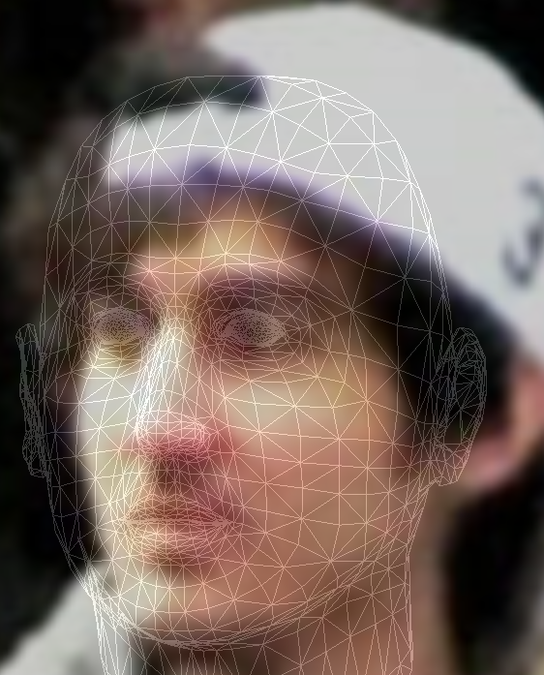
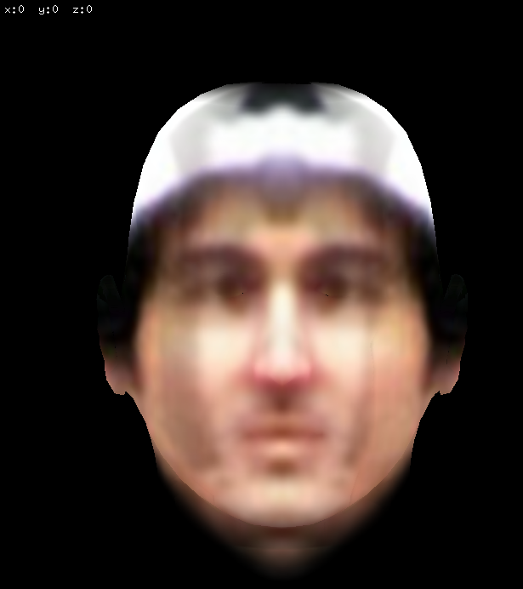
Will new facial technologies solve these problems?
Pose Correction with
3D Model Estimation

Slide 17
Summary
Fact: As of today, facial recognition technology can not reliably match face templates to identites based on photo harvesting of uncontrolled images from social networks, let alone in a video surveillance environment, without forensic support.
Fact: Controlled images are key to reliable matching, and thus the success of current facial recognition technologies.

